Slide 1

Project Report on:-
Housing Sales Price Prediction
Submitted By:- Ojasav Sahu
Internship :- 23

Slide 2
Index:-
Introduction:-
Introductions and Problem Statement
Need of House Price Prediction
Data Analysis
Exploratory Data Analysis(EDA)
Machine learning models
Conclusion
Learning outcomes of the study in respect to Data Science
Limitations and Scope for the Future work

Slide 3
Introduction and Problem Statement
Houses are one of the necessary need of each and every person around the globe and therefore housing and real estate market is one of the markets which is one of the major contributors in the world’s economy. It is a very large market and there are various companies working in the domain. Data science comes as a very important tool to solve problems in the domain to help the companies increase their overall revenue, profits, improving their marketing strategies and focusing on changing trends in house sales and purchases. Predictive modelling, Market mix modelling, recommendation systems are some of the machine learning techniques used for achieving the business goals for housing companies. Our problem is related to one such housing company.
A US-based housing company named Surprise Housing has decided to enter the Australian market. The company uses data analytics to purchase houses at a price below their actual values and flip them at a higher price. For the same purpose, the company has collected a data set from the sale of houses in Australia. The data is provided in the CSV file below.
The company is looking at prospective properties to buy houses to enter the market. You are required to build a model using Machine Learning in order to predict the actual value of the prospective properties and decide whether to invest in them or not. For this company wants to know:
• Which variables are important to predict the price of variable?
• How do these variables describe the price of the house?
We are required to model the price of houses with the available independent variables. This model will then be used by the management to understand how exactly the prices vary with the variables. They can accordingly manipulate the strategy of the firm and concentrate on areas that will yield high returns. Further, the model will be a good way for the management to understand the pricing dynamics of a new market

Slide 4
Need of House Price Prediction
House price forecasting is an important topic of real estate. The literature attempts to derive useful knowledge from historical data of property markets. Machine learning techniques are applied to analyse historical property transactions in India to discover useful models for house buyers and sellers. Revealed is the high discrepancy between house prices in the most expensive and most affordable suburbs in the city. Moreover, experiments demonstrate that the Multiple Linear Regression that is based on mean squared error measurement is a competitive approach
Property valuation is an imprecise science. Individual appraisers and values bring their own experience, metrics and skills to a job. Consistency is difficult, with UK and Australian-based studies suggesting valuations between two professionals can differ by up to 40%. Crikey!
Perhaps a well-trained machine could perform this task in place of a human, with greater consistency and accuracy.

Slide 5
Data Analysis:-
Firstly, I’m removing the variables that contains ‘missing data’ more than 80%. We can clearly see that for the variables 'Alley', 'MiscFeature' and 'PoolQC', there are more than 80% data is missing, hence removing the same. Further I’m also removing ‘Id’ because it is unique for each row and will not help in the Prediction of sale price.
Before we can proceed with data analysis part, there are missing data in some of the variables which needs to be handled the variables like LotFrontage, Alley, MasVnrType, MasVnrArea, BsmtQual, BsmtCond, BsmtExposure, BsmtFinType1, BsmtFinType2, FireplaceQu, GarageType, GarageYrBlt, GarageFinish, GarageQual, GarageCond, PoolQC, Fence and MiscFeature have missing data.
Further, I’m imputing all the other variables containing null values using KNN Imputer and fillna method
Using the above technique, I have successfully handled the null values in the dataset.

Slide 6
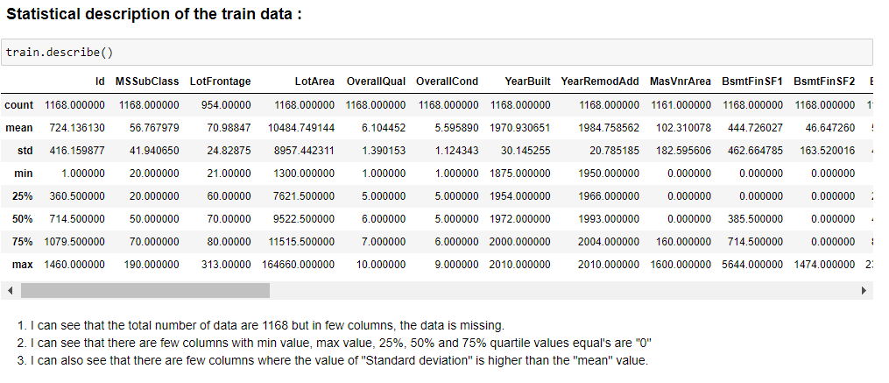
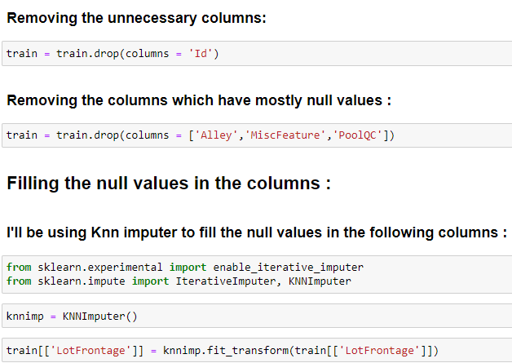
Exploratory data analysis

Slide 7
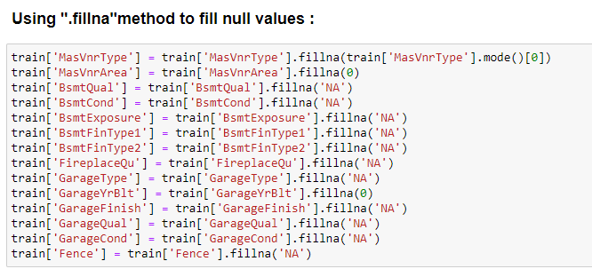
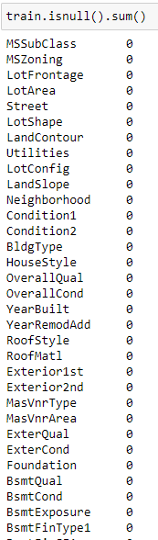

Slide 8
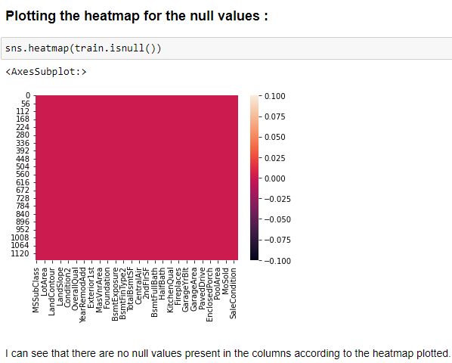
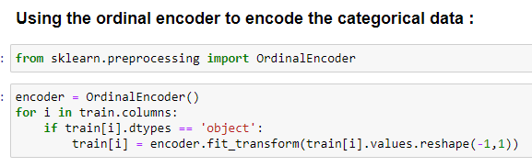

Slide 9
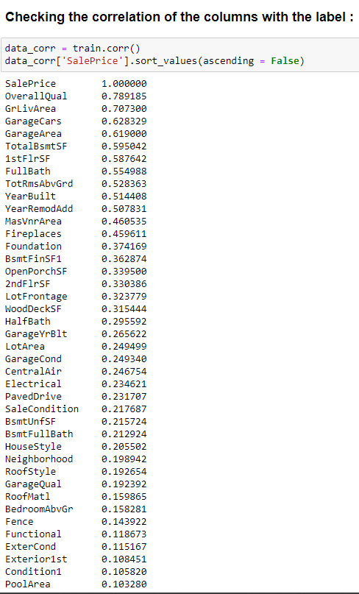
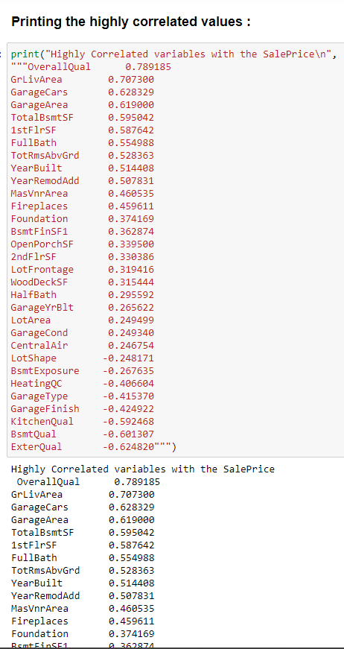

Slide 10
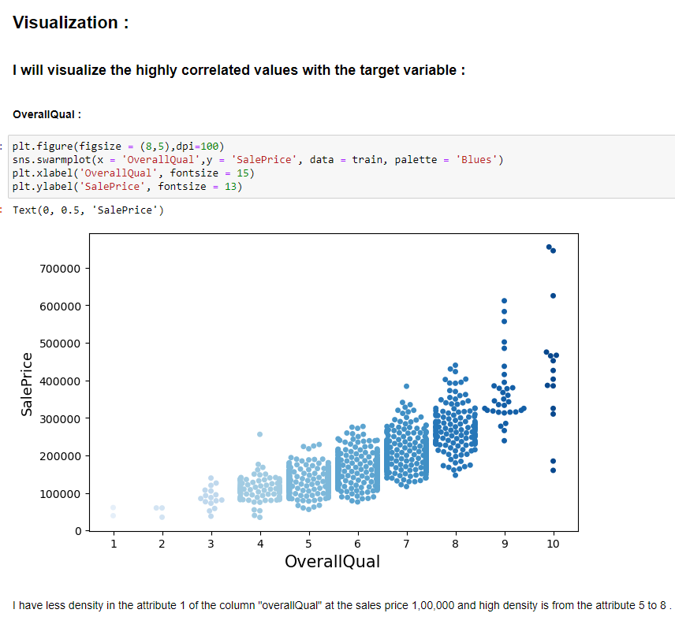
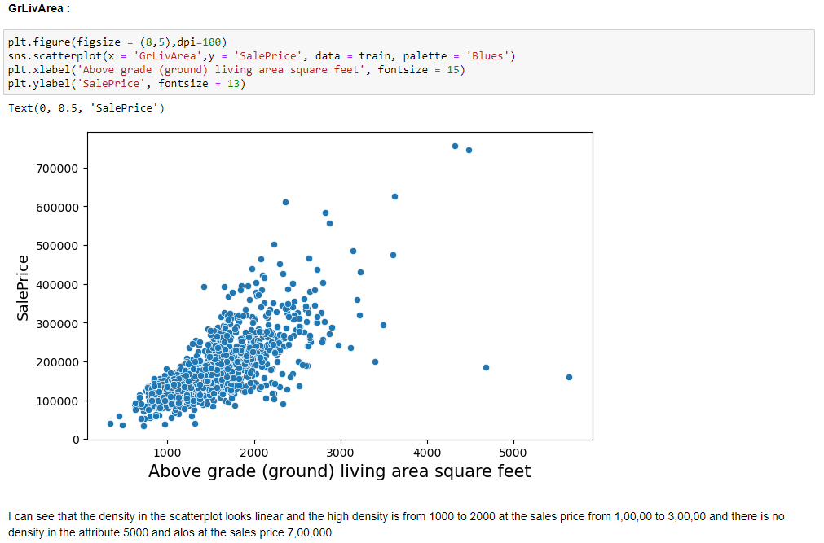

Slide 11
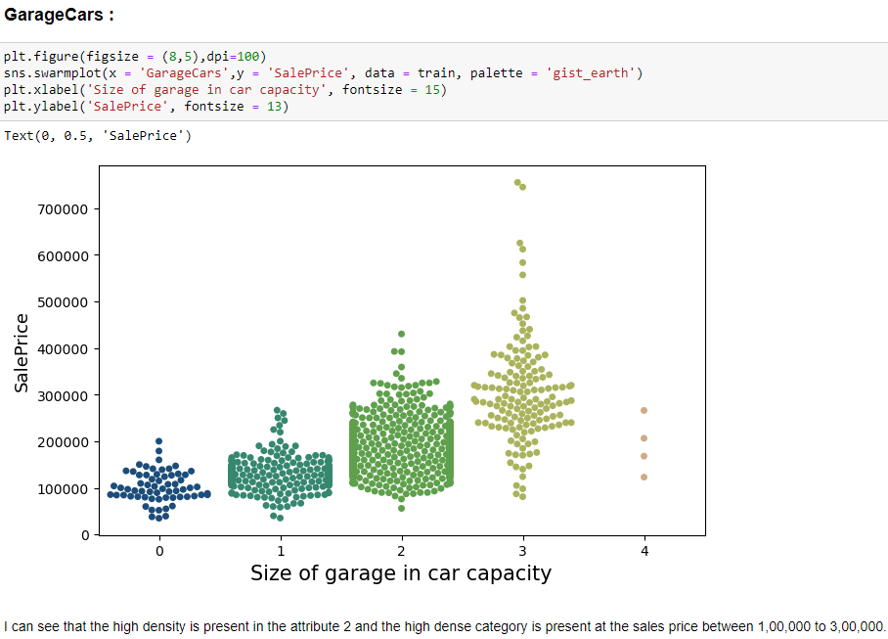
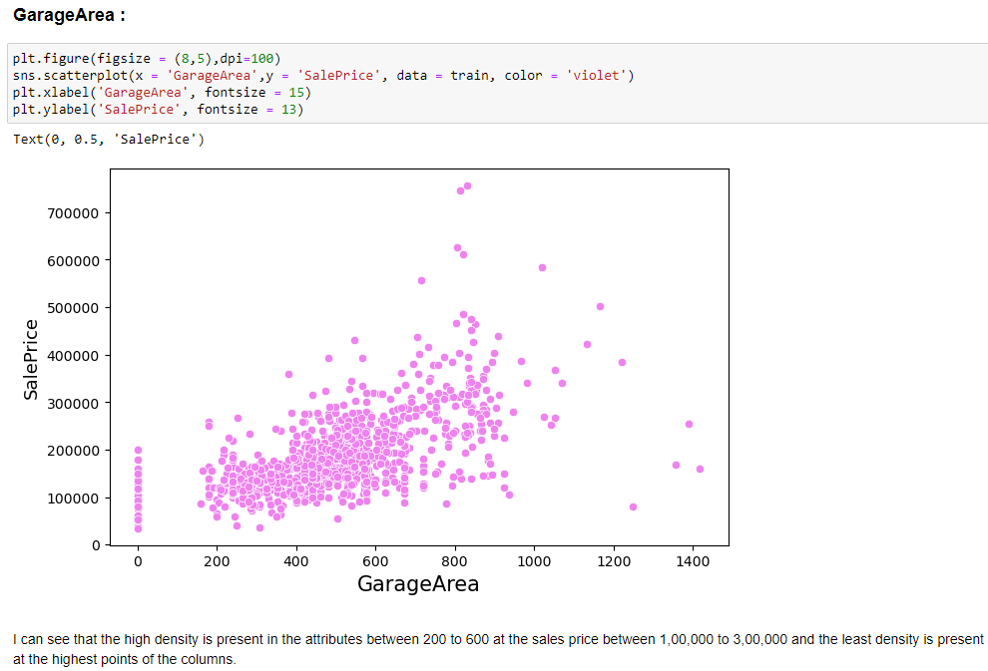

Slide 12
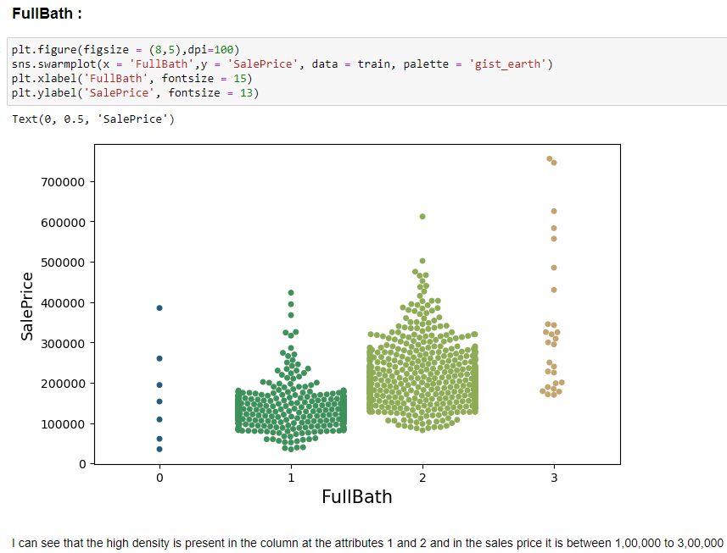
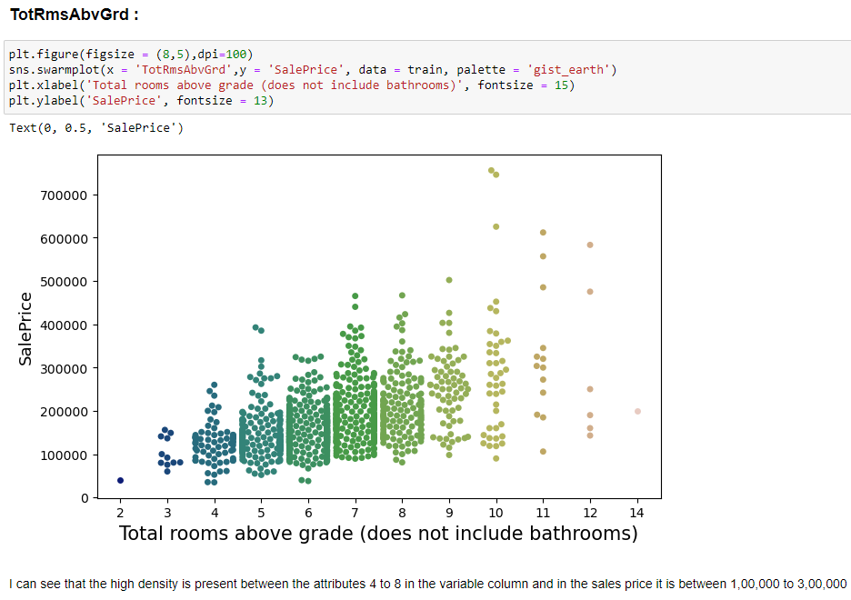

Slide 13
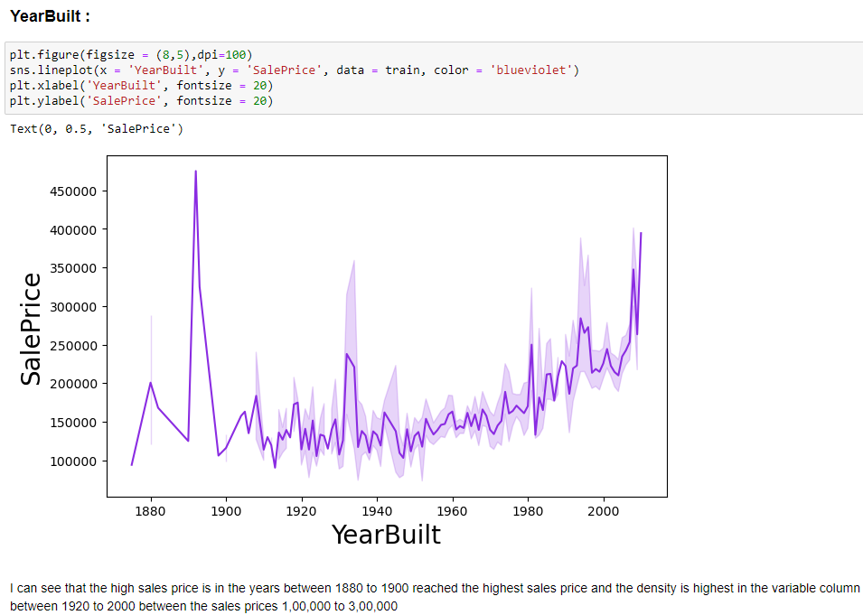
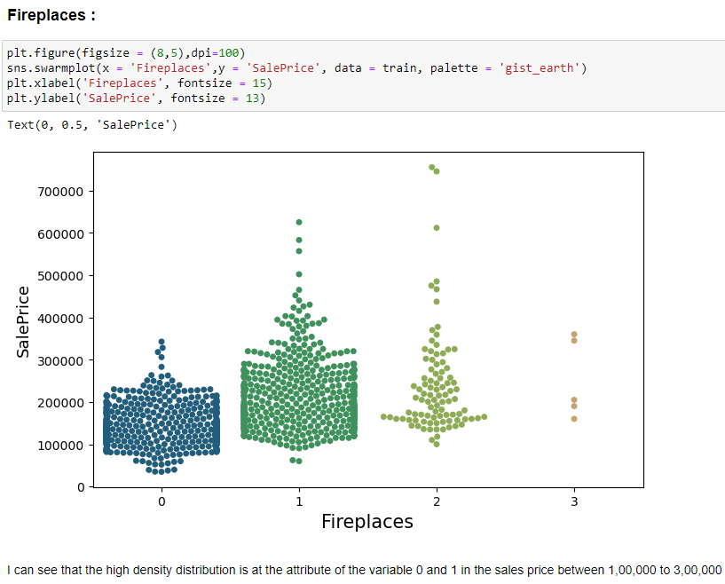

Slide 14
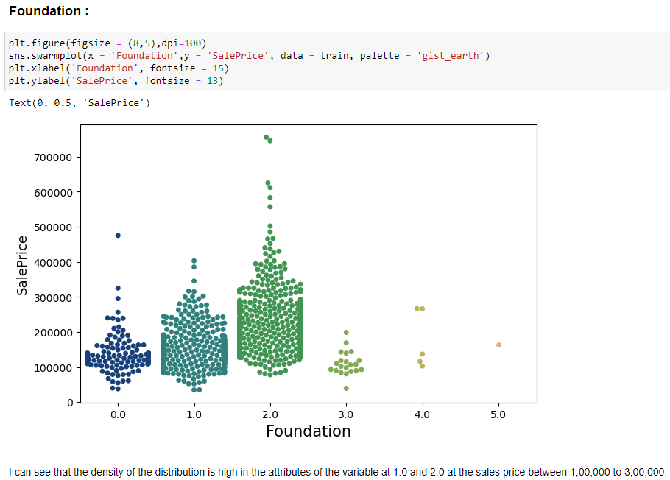
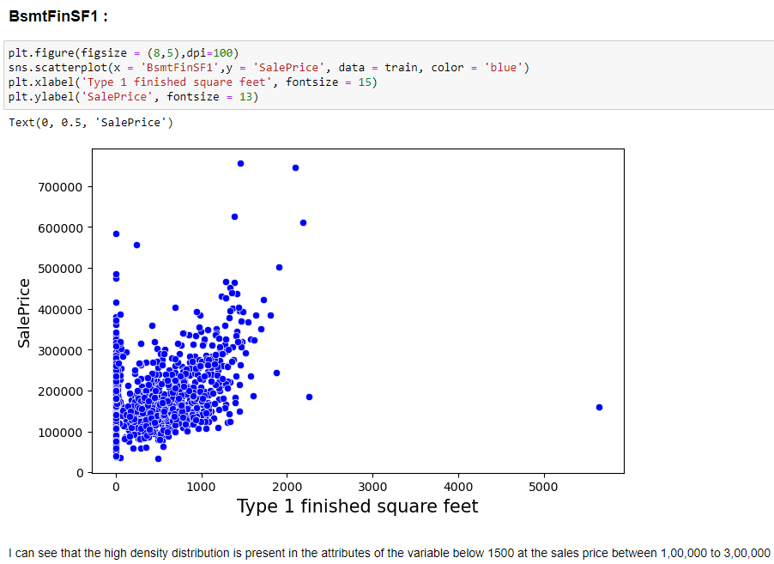

Slide 15
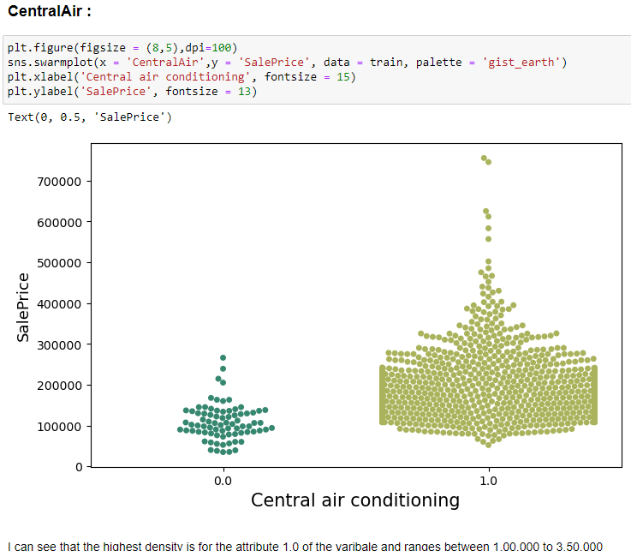
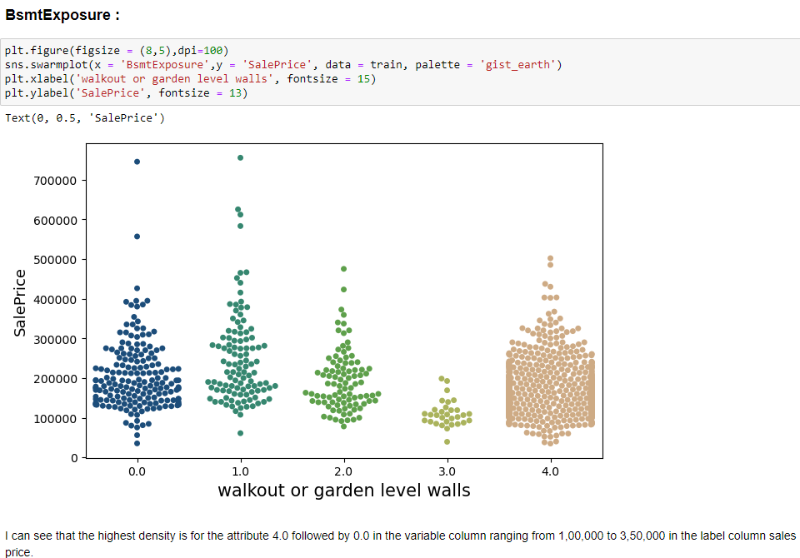

Slide 16
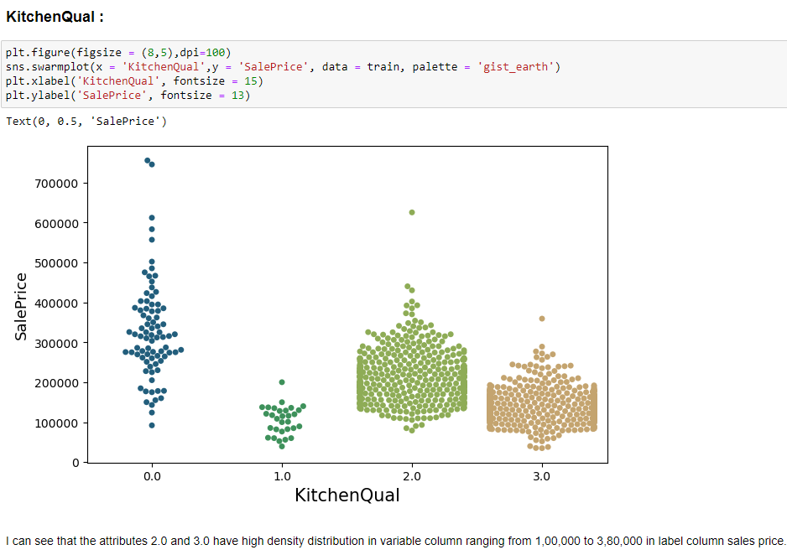
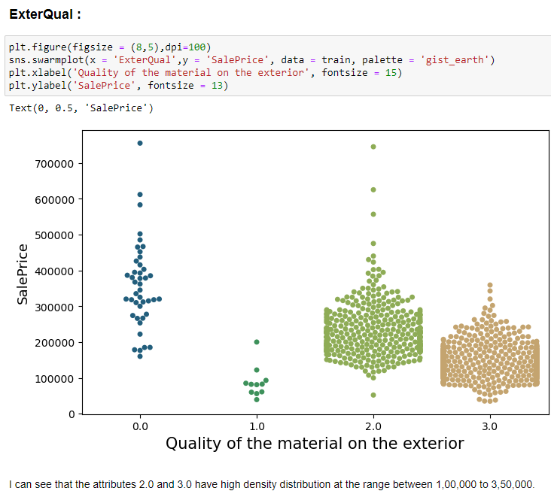

Slide 17
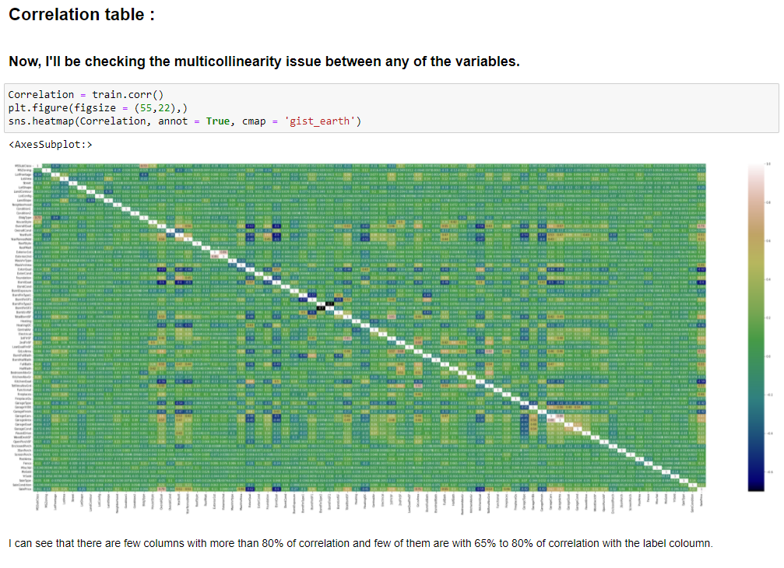

Slide 18
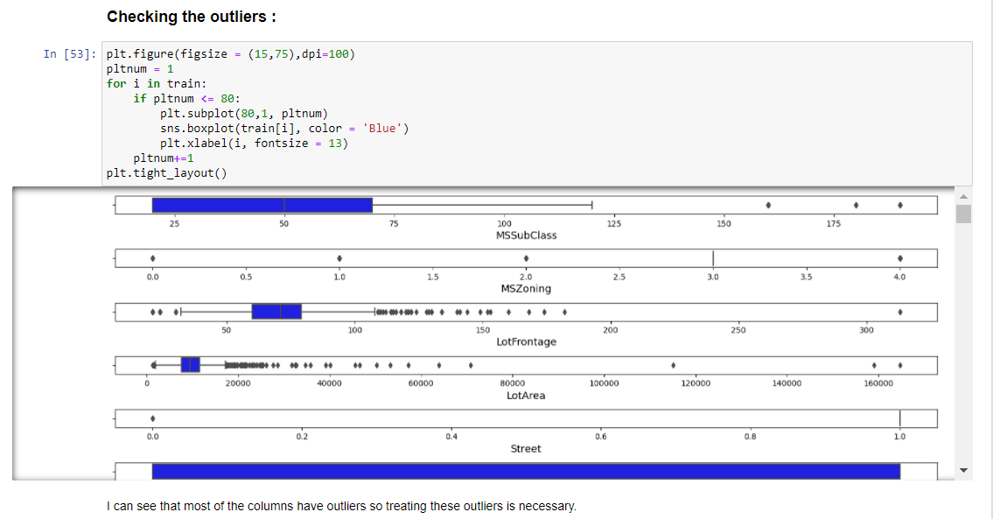
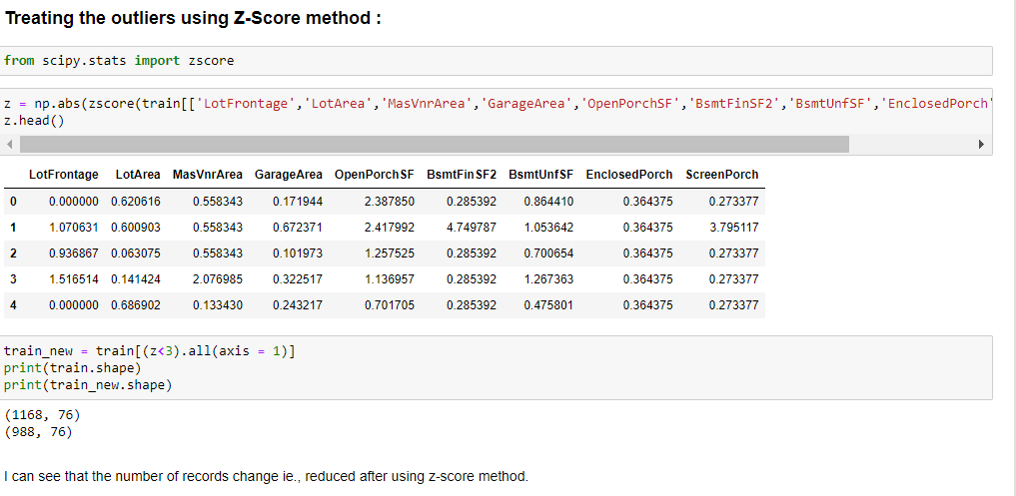

Slide 19
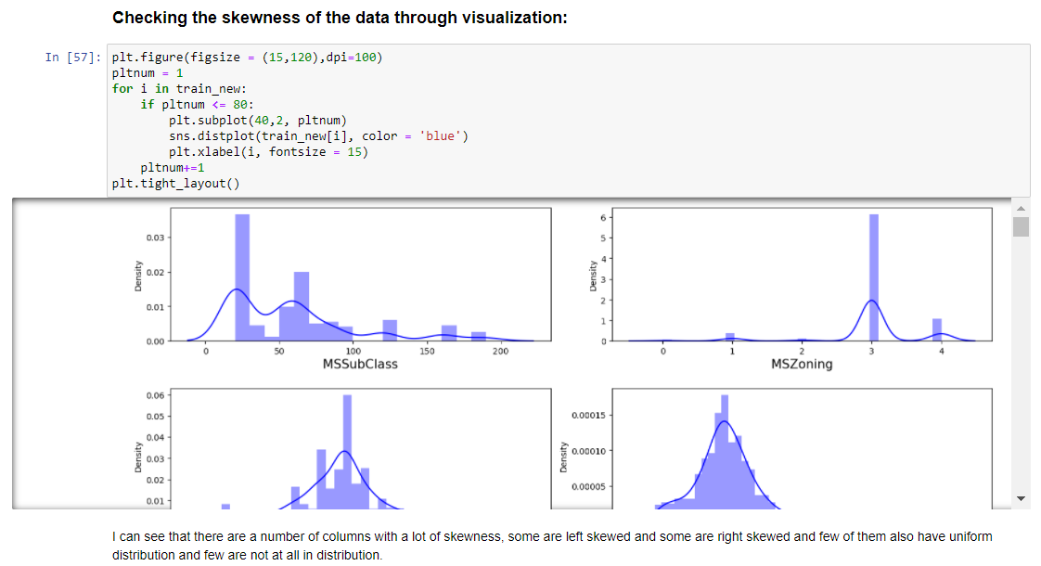
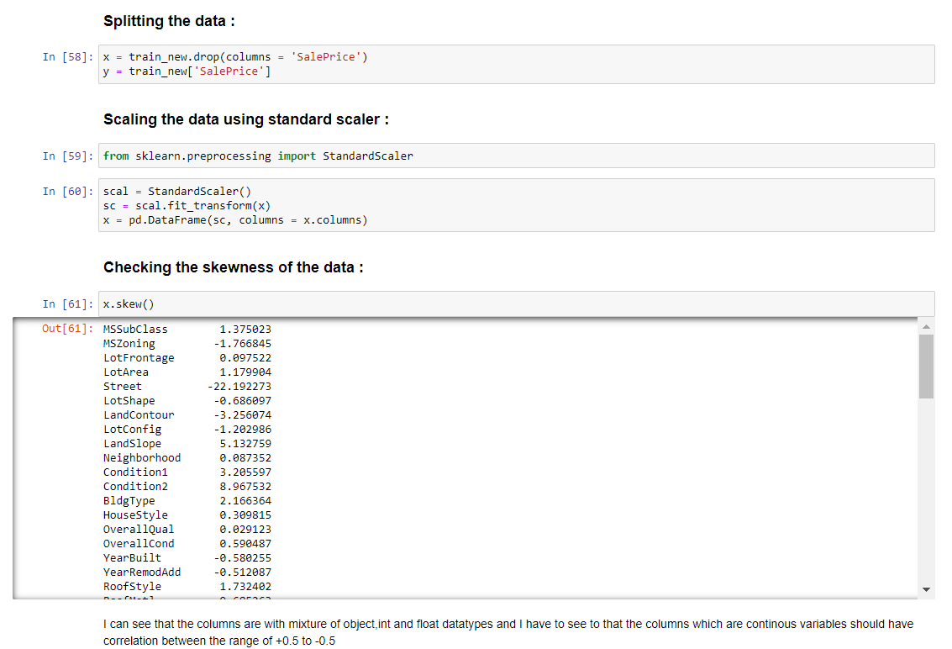

Slide 20
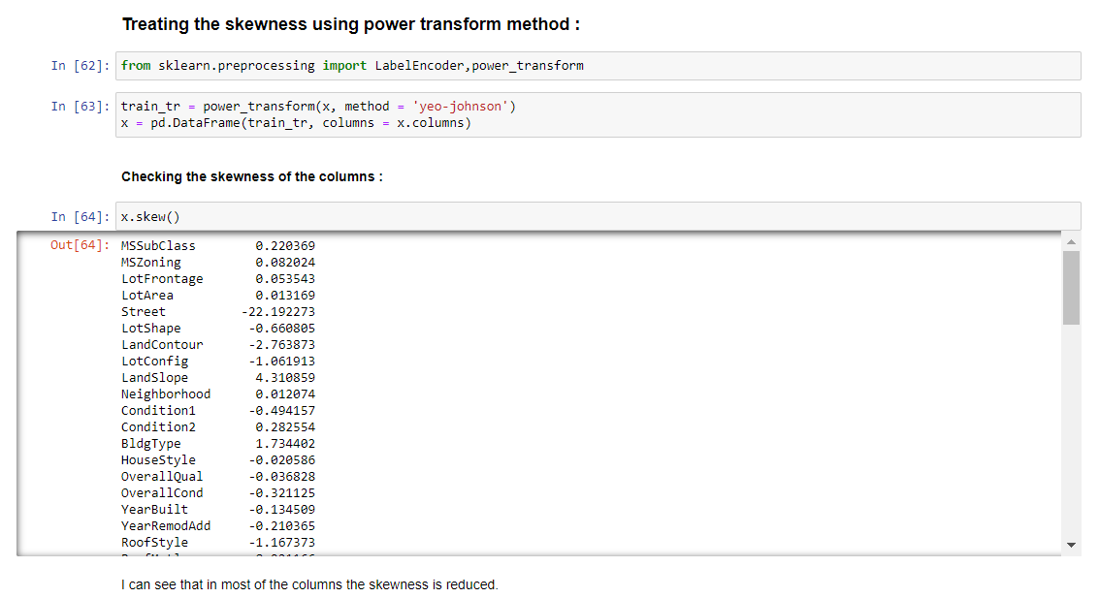
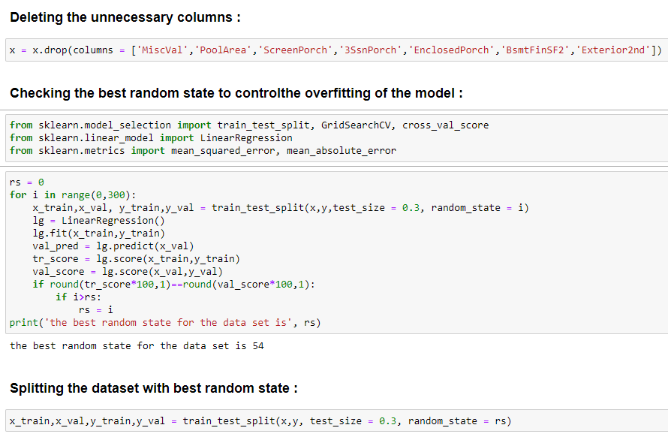

Slide 21
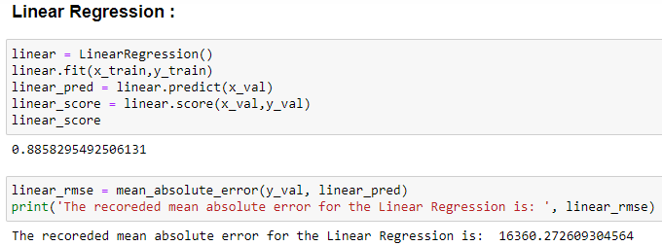
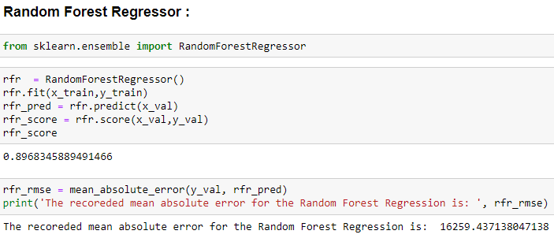
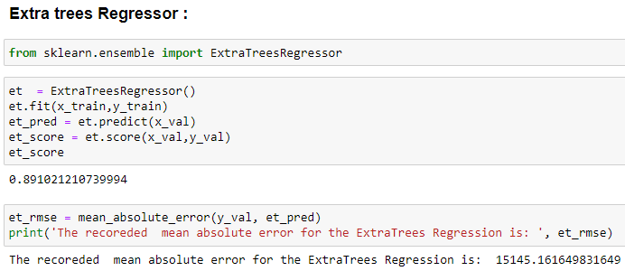
Machine Learning Models:-

Slide 22
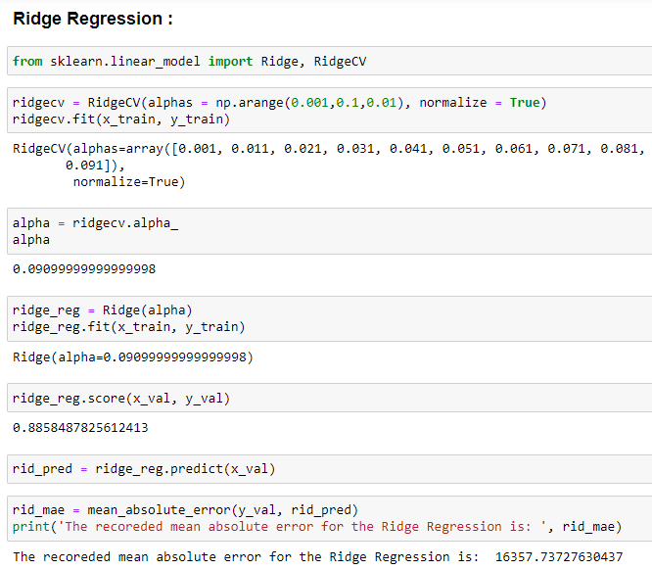
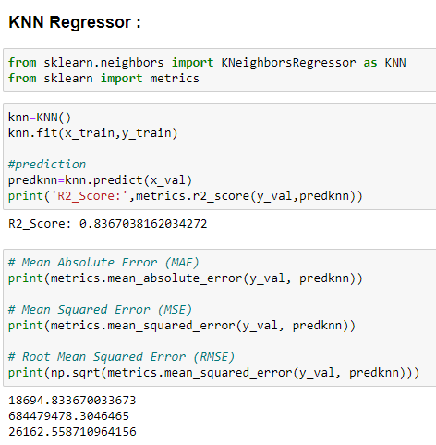

Slide 23
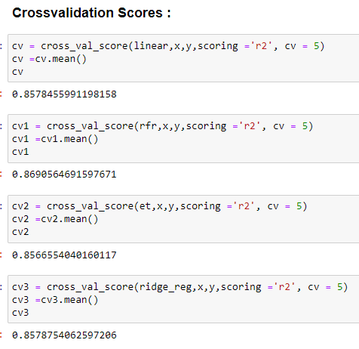
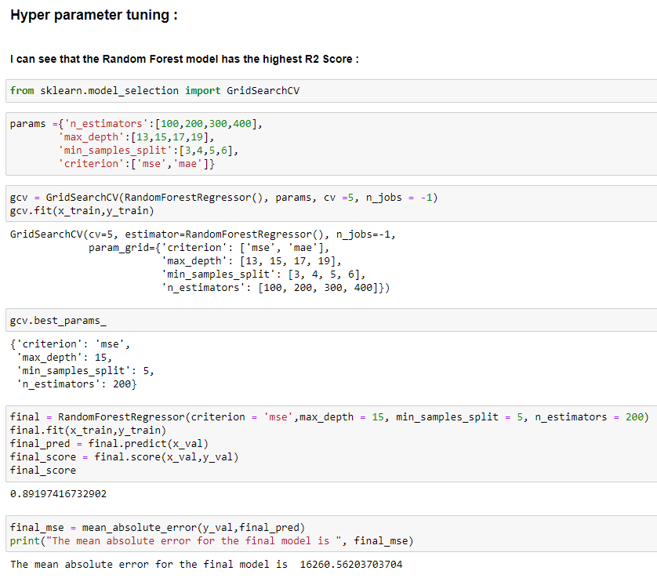

Slide 24
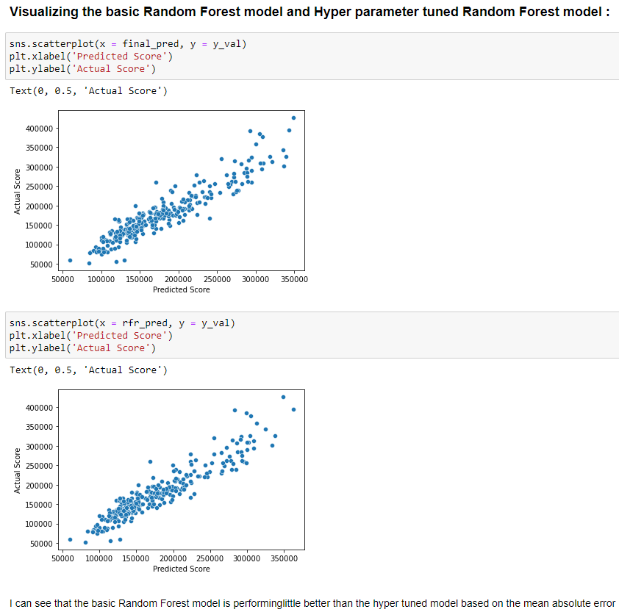
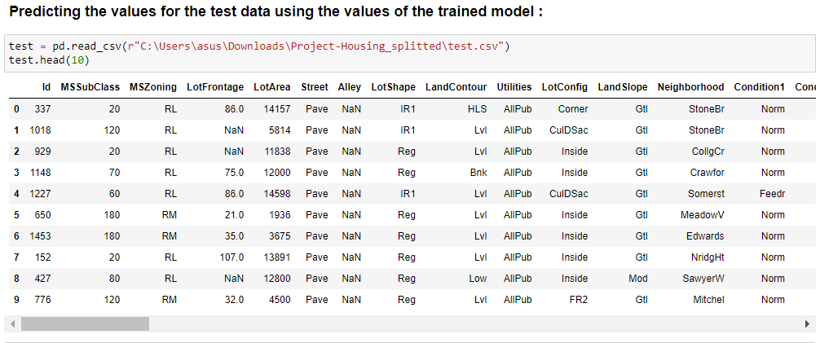

Slide 25
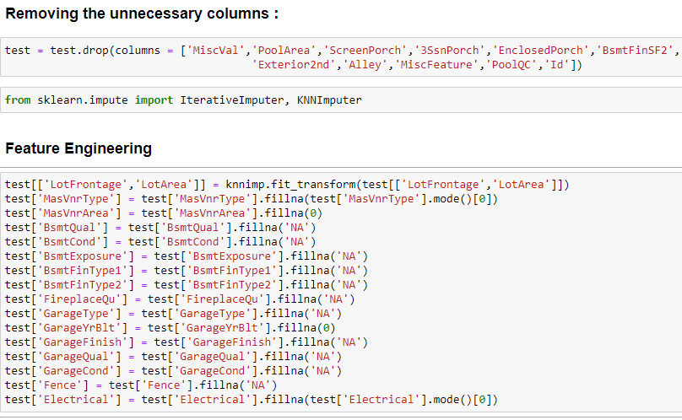
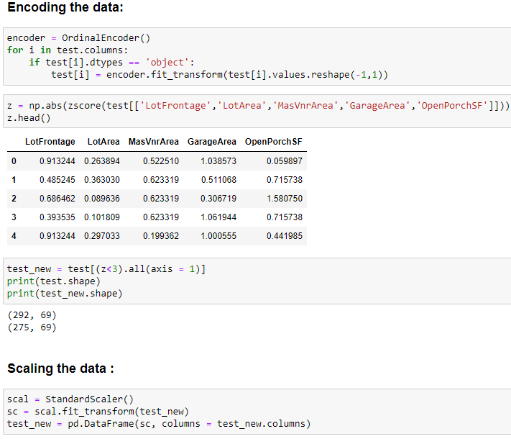

Slide 26
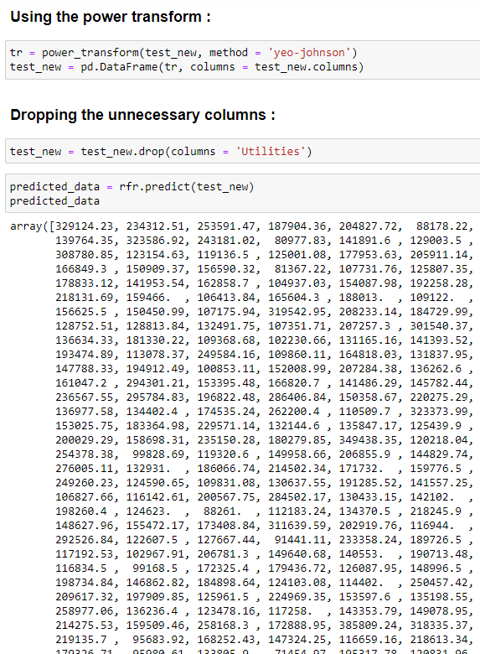
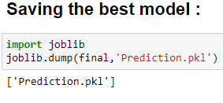

Slide 27
Conclusion:-
I have successfully built a model using multiple models and found that the Random Forest Regressor model. Below are the details of the model’s metrics predicting the dataset . R2 score is 16259.4371 38047138 and Mean Absolute error is 16259.437138047138.
Learning Outcomes of the Study in respect of Data Science:-
Linear Regression is a machine learning algorithm based on supervised learning.
It performs a regression task. Regression models a target prediction value based on independent variables.
It is mostly used for finding out the relationship between variables and forecasting. A Random Forest is an ensemble technique capable of performing both regression and classification tasks with the use of multiple decision trees and a technique called Bootstrap Aggregation, commonly known as bagging.
Bagging, in the Random Forest method, involves training each decision tree on a different data sample where sampling is done with replacement.
The basic idea behind this is to combine multiple decision trees in determining the final output rather than relying on individual decision trees

Slide 28
Limitations and Scope for Future Work:-
The amount of data is very less, it would be better to have more data to predict the sale price more accurately.
There are more outliers in the provided data and I was unable to remove all the outliers because I could lose data. With more data more outliers can be removed from the dataset.
Other than these above limitations, I couldn’t find more scope for improvement.

Slide 29


